Slide 1
Git Introduction

Slide 2



Did you finish pre-class work?
Notes:
Hard or Easy
Use this template to do a quick temperature check and self-reflection about the homework. You can learn which students might have struggled with the assignment and therefore might need more attention today.
🍐 This is a Pear Deck Draggable™ Slide.
🍐 To edit the type of question, go back to the "Ask Students a Question" in the Pear Deck sidebar.
If you didn’t you can have some issues today.
It’s not a different subject but it might be a little bit confusing at first. Once you’ve learned, it’s a piece of cake.
Learning curve is high at first.
It’s not that complicated.

Slide 3

Git Journey
Git introduction Git workflow
Local repo operations
Branches
Merge
Conflicts
Remote repo
GitHub
GUI
Contribution to the Public Repository
Forking
Pull request
More Practice with Git

Slide 4
Table of Contents
What is version control?
What is Git?
How to create a Git repository?
Basic Git commands
Git workflow

Slide 5

What do you know about Git?
Let’s discuss about Git

Slide 6

What is Git?
Git is an open source distributed version control system

Slide 7
What’s Version Control?
1

Slide 8
What’s Version Control?
Version Control Systems
What comes to your mind when you hear this?
Notes:
🍐 This is a Pear Deck Text Slide
🍐 To edit the type of question, go back to the "Ask Students a Question" in the Pear Deck sidebar.
Today no coding,
Pre-class, what did you learn about Git?
In IT, there’s a tenancy to use more complicated words. Big Words.
It’s just vocabulary. We’ll see a lot of those words today.
I’ll make things simpler.
Let’s hear your thoughts.

Slide 9
What’s Version Control?
Track changes on text files / source files for you
Unlimited Undo / Redo
Time Travel
Collaborative development environment
Compare and Blame
What changed
When it changed
Why it changed
Who changed it
Notes:
What are text files? What is source file?
Give me an example? Are you going to write source file?
Python file, Ansible file, docker files etc.
do you have a luxury to lose the code you wrote??
They’re paying for that code and every code a has a price tag.
Jira, every ticket has a price on it. how many people worked on that ticket. how many hours. So feature
What is undo who knows to do undo?
Word document example.
Undo Redo example.
Show undo button on word document.
Many people works collaboratively.
To make it happen we need a system.
What is Codebase?

Slide 10
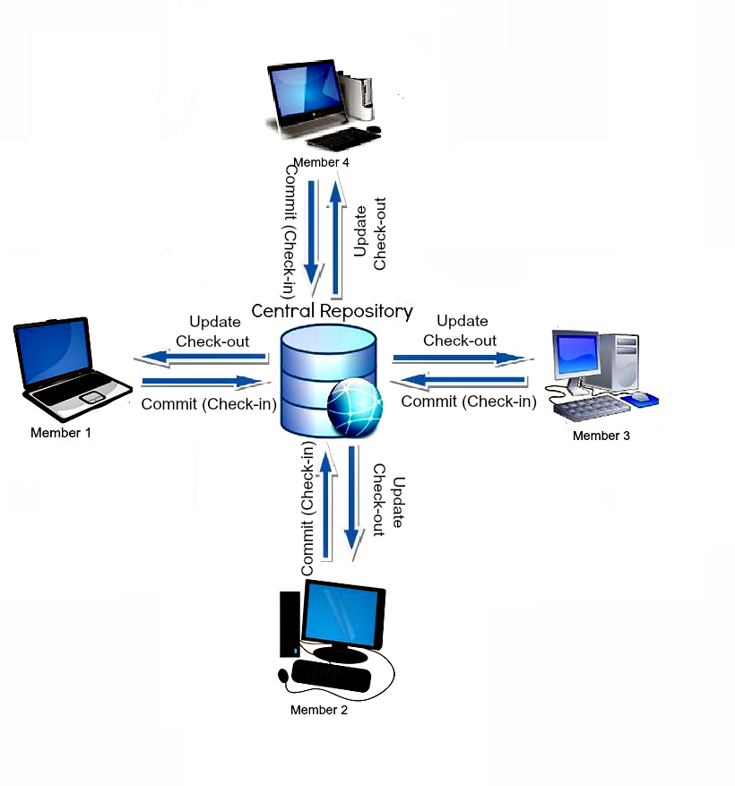
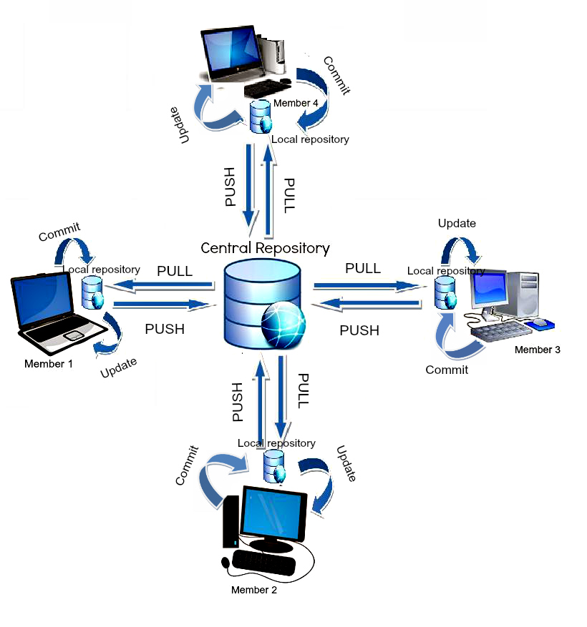
Version Control Systems
Centralized
Distributed
You need to be connected to the server You can work while offline

Slide 11




What’s Version Control?
A version control system is a system that tracks and records changes to a select group of files over time, so that previous versions of those files can be retrieved easily in the future.
Time
03/22/2020
03/24/2020
03/25/2020
reference_letter
reference_letter
resume
resume
resume
kbaşsfdkbvşkdjkhvşkhvmkhv*
kbaşsfdkbvşkdjkhvşkhvmkhv*
kbaşsfdkbvşkdjkhvşkhvmkhvkk
kbaşsfdkbvşkdjkhvşkhvmkhvkk
kbaşsfdkbvşkdjkhvşkhvmkhv*
Your
folder
Add “about” section to resume
Create “reference letter” file
Add photo and change layout
resume.doc
modified
reference_letter.doc
created
resume.doc
modified
VCS
Add “education” section to resume
resume.doc
modified

Slide 12
What’s Version Control?
Version Control Systems (VCS)
Tracks and records changes to files over time
Can track any type of file, but most commonly used for code
Contains extra information such as date, author, and a message explaining the change

Slide 13
What’s Version Control?
Benefits of Version Control Systems (VCS)
Can retrieve previous version of files at any time
Retrieve files that were accidentally deleted
Can be used locally, or collaboratively with others

Slide 14
What is Git?
2

Slide 15
What is Git?
Git is a software
Content Tracker
Distributed Version Control System (VCS)
Linus Torvalds
Notes:
Fundamental part of your everyday life.
You’re going to use everyday. It’s very important to understand the concept.
Interview questions you’ll be asked a lot about this subject.
Daily use. if you don’t know how to use it it’s going to create a problem.
You write your code, you can store your code in your computer right now.
In IT environment, your computer is not reliable, you can drop your computer, you can lose it,
You need to make a lot of copies and backup.
How would you do it? If you want to save your files, would you put version numbers? Date? etc.
version 1, version 2, version 3.
You will not need versioning file anymore.
But at the end of the day you need to store your code in somewhere safe, which is cloud.
The name of the cloud might be different Github, Bitbucket, Gitlab etc.
But the application used in every case is Git.

Slide 16
Why do we need Git?
Backup/Archive/Versioning/History
Undo Changes
Comparing
Collaboration and Teamwork
Code Review
Blame
Notes:
Code: Money
Compare: previous version of the code
Collaboration & teamwork:
Bad guy :) Code reviews. Team mate/Team lead. They can improve or correct the code.
Engineer making $200K, but can cause problem worth millions of dollars.
Database.
Storing the data as files.
Git stores the data as objects.
SHA1
Collaboration - Testers, Developers, DevOps Engineer
Communication will be on Git
Pipeline CI/CD : Test automation to CI/CD is impossible
Early testing : Fast feedback. Testing is a matter
Learning : Gateaway to more advanced …
Bash scripting, pipeline integration etc.

Slide 17



Git Basics
Backup
In any case if your remote server crashes, a backup is available in your local servers.
Remote copy
Local copy 1
Local copy 2
Local copy 3

Slide 18

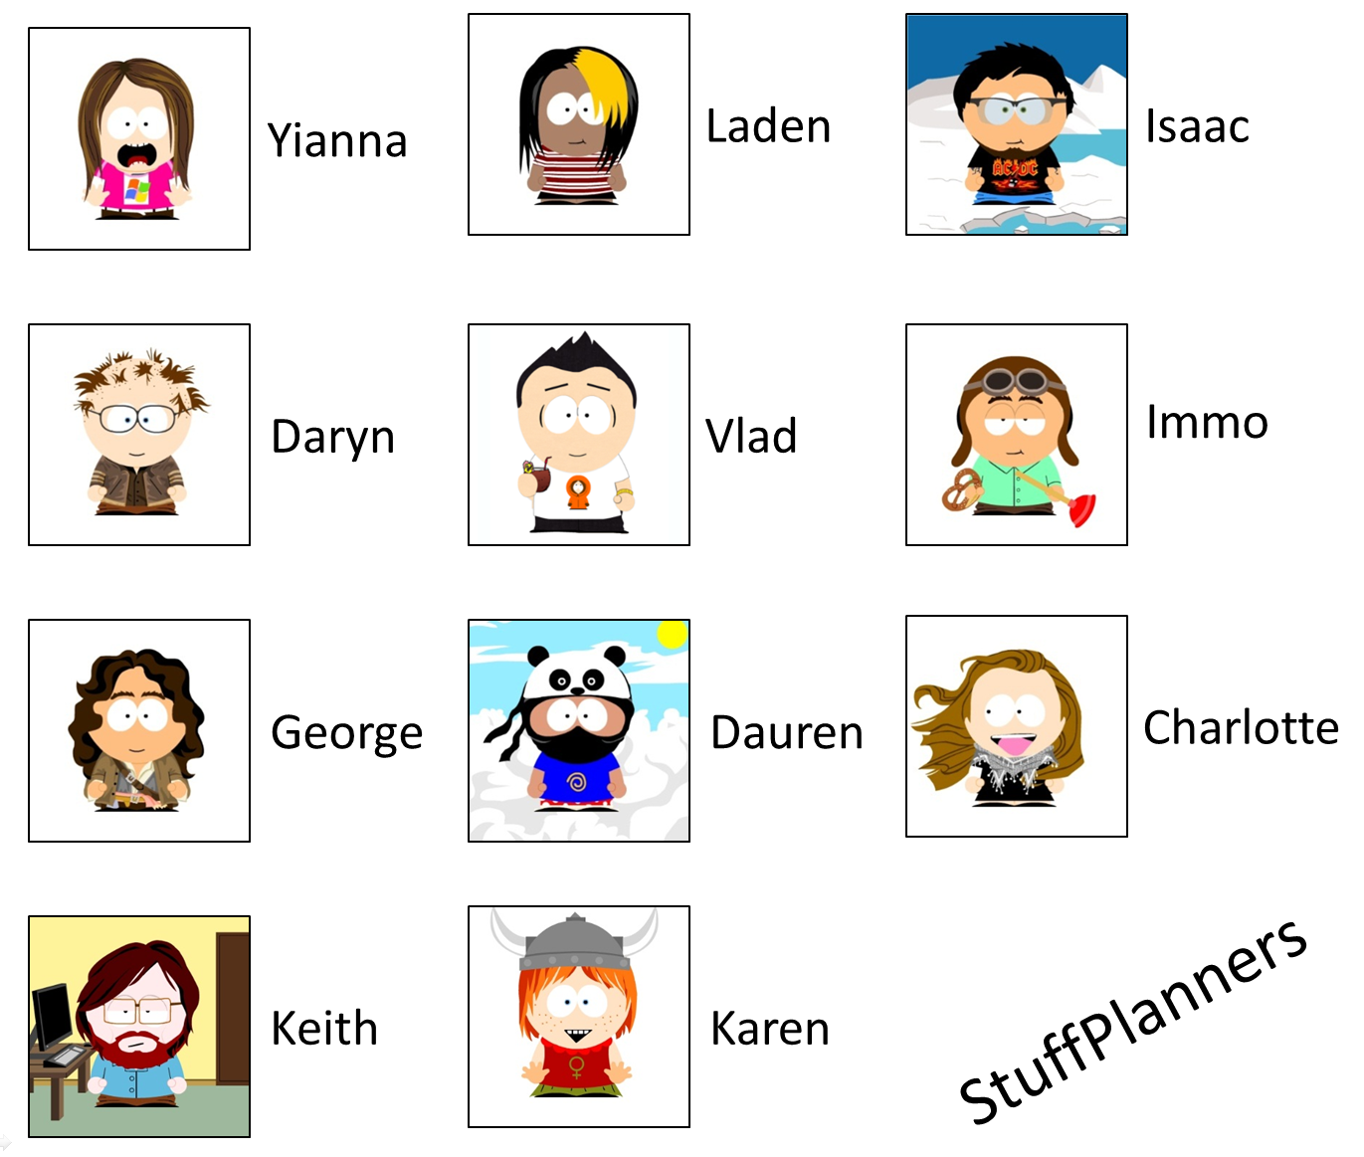
Git Basics
Collaboration
Task 1
+
Task 2
+
Task 2
Combined Tasks

Slide 19
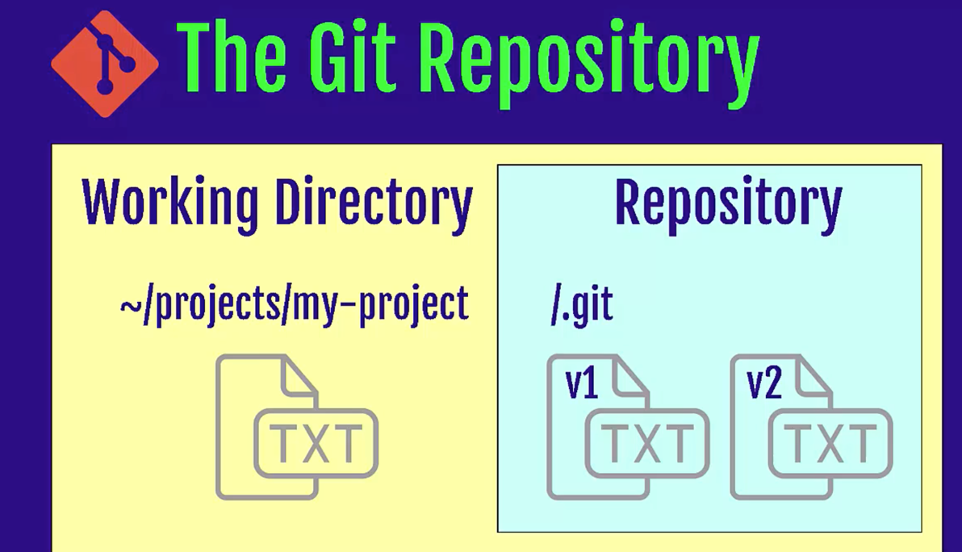
Git Repository
What is a repository
A directory or storage space where your projects can live.
Local Repository
Remote Repository
Notes:
Let’s start getting our hands dirty.
Step by step.
Try to do whatever I do.
What is CLI?
Why do we use CLI over GUI?
Some CLI commands. You’ll see more commands tomorrow. It’s a demo only.
Repository is not only your files but also all the information about the changes made on your project files.
Repo can live in your computer or remotely on hosted server (cloud)
Let’s see what it looks like?
Git doesn’t care about working directory a lot.
Because it can be changed immediately.
Desktop create a folder named projects
capital-one-project
check git is installed correctly
git config --global user.name “Name”
git config --global user.email
git init

Slide 20


Git Repository
Notes:
Let’s see what it looks like?
lets create on our terminals
show them .git folder.
objects etc.

Slide 21
Git Repository
Let’s check if you have git in your computer
git --version t
git needs your identity to mark/label changes / editor
git config --global user.name “Your Name” t
git config --global user.email “Your Email” t
git config --global core.editor “vim” t
git config --list t
Notes:
For different repositories if you like to define different username or email use the command without global option.
git config user.name

Slide 22
Git Repository
to create a new local repo
git init t
to see the commands
git helpt
to see the status of your repo
git status t
Notes:
Let’s see what it looks like?
Let’s start playing with Git.
Windows powershell / gitbash
Mac terminal
Let’s create a folder on Desktop for convenience. my-projects
mkdir my-projects
What happened
to see what happened let’s go to project folder
It’s nothing but so many folders and files.
hidden files
To delete your repository, just delete the folder.

Slide 23
Git Repository
to create a new remote repo and connect it with your local repo (after you create a remote repo on Github/Bitbucket etc.)
git clone address t
Notes:
We’re going to see remote repo operations on the next session.
just fyi.

Slide 24
Workflow
3

Slide 25
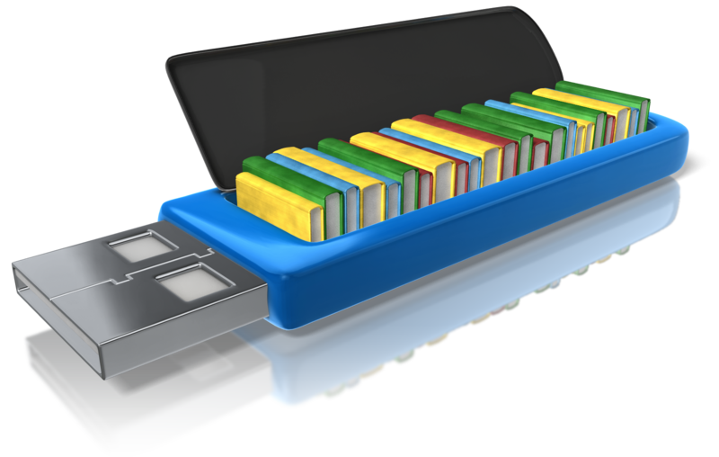
Workflow
Working Directory Staging Area (Index) Repository
Where you work. Create new files, edit files delete files etc.
Before taking a snapshot, you’re taking the files to a stage. Ready files to be committed.
Committed snapshots of your project will be stored here with a full version history.
Notes:
It’s like a shopping cart or a rocket launch.
Until you buy the items are not yours.
go to register and pay then it’s yours, repository is your refrigerator or pantry.

Slide 26
File Stages
Committed
Unmodified changes from the last commit snapshot
Modified
Changes made to files since last commit snapshot
Staged
Changes marked to be added into the next commit snapshot

Slide 27
Track a new file
let’s create a new file in our project folder
touch file1.txt t
let’s edit this file
vim file1.txt t
let’s check the status of our project
git status t

Slide 28
Git
Stage modified files & commit changes

Slide 29
Create a new file
Working Directory Staging Area (Index) Repository
resume.txt
untracked file

Slide 30
Track/stage a file
Working Directory Staging Area (Index) Repository
resume.txt
resume.txt
git add

Slide 31
Stage files options
stage one file
git add filename t
stage all files (new, modified)
git add . t
stage modified and deleted files only
git add -u t

Slide 32
Commit
Working Directory Staging Area (Index) Repository
resume.txt
resume.txt
resume.txt
git commit -m

Slide 33
Commit
Working Directory Staging Area (Index) Repository
resume.txt
resume.txt
resume.txt
git commit -m
git log t
Master

Slide 34
Commit
Commit the files on the stage
git commit -m ”message” t
Add and commit all tracked files
git commit -am ”message” t
amend commit message
git commit --amend t
Notes:
Commit often
Write clear commit messages

Slide 35
Remove from stage
Working Directory Staging Area (Index) Repository
resume.txt
new_file.txt
resume.txt
new_file.txt
git rm --cached
git restore --staged

Slide 36
Checkout from Repo
Working Directory Staging Area (Index) Repository
resume.txt
new_file.txt
resume.txt
new-file.txt
resume.txt
new-file.txt
git checkout

Slide 37
Git
will talk about later
Local Machine
GitHub
Working directory
Staging area (index)
Git repository
Remote Git repository
git add
git commit
git checkout
Notes:
Let’s start with cloning.
Let’s create a new repo and put a new file on it. Do our first commit.
mkdir gitprojects
499 cd gitprojects/
500 git clone https://github.com/clarusway/labb.git
501 ls
502 git ls
503 ls
504 cd labb
505 ls
506 vim file2.txt
507 git status
508 git add .
509 git commit -m "mee"
510 git s
511 git push origin master
Secondly give them the link of your code and show fork. change it.
Then show them to clone again. remote to remote and then clone.
Scenario: git clone, change the file on remote, git status, git fetch, git merge
then do the same thing with git pull.
change 1 file and try to push before pull see the problem. git pull
Visual representation
Create a commit and push
create a branch and push
local: merge the branch
push
git commit
git commit
git push origin master
git pull
Fetched 0 commits on master.
Already up-to-date.
git fetch
Fetched 0 commits on master.
git branch eric
git push
Everything up-to-date.
git checkout eric
git commit
git commit
git push origin eric
git checkout master
git merge eric
You have performed a fast-forward merge.
git push origin master
Remote visual representation:
git push origin master
Push rejected. Non fast-forward. Try pulling first
git pull
Fetched 0 commits on master.
Fetched 1 commits on feature.
Fast-forwarded to origin/feature.
git commit
git commit
git push origin feature
git checkout master
git merge feature
git push

Slide 38
New project
Create a repo git init t
Create a new file/edit file etc.
Stage/Track your changes git add . t
Commit changes git commit -m “message”t

Slide 39
Task-1
Create a new repo under project-3 folder
Create a file named file1.txt
Change the file
Stage the file
Commit the file to your repo
Notes:
🍐 This is a Pear Deck Text Slide
🍐 To edit the type of question, go back to the "Ask Students a Question" in the Pear Deck sidebar.

Slide 40
Task-1 Solution
Create a new repo under project-3 folder git init t
Create a file named file1.txt touch file1.txt t
Change the file vim file1.txt t
Stage the file git add . t
Commit the file to your repo git commit -m “message”t

Slide 41
Task-2
Create a file named file2.txt
Edit file2.txt
Stage
Delete the file file1.txt
Rename file2.txt >> file3.txt
Stage file3.txt
Unstage file3.txt
Stage file3.txt again
Commit the file to your repo
Change the message of the commit
Switch back to your first commit in Task-1
Notes:
🍐 This is a Pear Deck Text Slide
🍐 To edit the type of question, go back to the "Ask Students a Question" in the Pear Deck sidebar.

Slide 42
Task-2 Solution
Create a file named file2.txt touch file2.txt t
Edit file2.txt vim file2.txt t
Stage git add . t
Delete the file file1.txt rm file1.txt t
Rename file2.txt >> file3.txt mv file2.txt file3.txt t
Stage file3.txt git add . t

Slide 43
Task-2 Solution Cntd.
Unstage file3.txt git rm --cached file3.txt t
Stage file3.txt again git add . t
Commit the file to your repo git commit -m “message” t
Change the message of the commit
git commit --amend t
Switch back to your first commit in Task-1 git log t
git checkout “first commit ID” t

Slide 44
Git
Summary
Notes:
The third category of person to speak about when discussing an implementation of Git is the person who will use it for a long time, find all its deep services and features, and in fact want to stretch it to its absolute maximum.
That person is also served well by Git. Even though it's very easy for the introductory person, it's also very capable for the advanced individual.
You can find that through its Unix-like structure, the ability to glue together these small programs and use option switches to control the behavior, that it suits the needs of an advanced version control user extremely well.

Slide 45
Summary
will talk about next session
Local Machine
GitHub
git init
git status
git add .
git commit -m “abc”
git log
git checkout
Working directory
Staging area (index)
Git repository
Remote Git repository
git add
git commit
git checkout
Notes:
Let’s start with cloning.
Let’s create a new repo and put a new file on it. Do our first commit.
mkdir gitprojects
499 cd gitprojects/
500 git clone https://github.com/clarusway/labb.git
501 ls
502 git ls
503 ls
504 cd labb
505 ls
506 vim file2.txt
507 git status
508 git add .
509 git commit -m "mee"
510 git s
511 git push origin master
Secondly give them the link of your code and show fork. change it.
Then show them to clone again. remote to remote and then clone.
Scenario: git clone, change the file on remote, git status, git fetch, git merge
then do the same thing with git pull.
change 1 file and try to push before pull see the problem. git pull
Visual representation
Create a commit and push
create a branch and push
local: merge the branch
push
git commit
git commit
git push origin master
git pull
Fetched 0 commits on master.
Already up-to-date.
git fetch
Fetched 0 commits on master.
git branch eric
git push
Everything up-to-date.
git checkout eric
git commit
git commit
git push origin eric
git checkout master
git merge eric
You have performed a fast-forward merge.
git push origin master
Remote visual representation:
git push origin master
Push rejected. Non fast-forward. Try pulling first
git pull
Fetched 0 commits on master.
Fetched 1 commits on feature.
Fast-forwarded to origin/feature.
git commit
git commit
git push origin feature
git checkout master
git merge feature
git push

Slide 46

THANKS!
Any questions?

